Slide 1
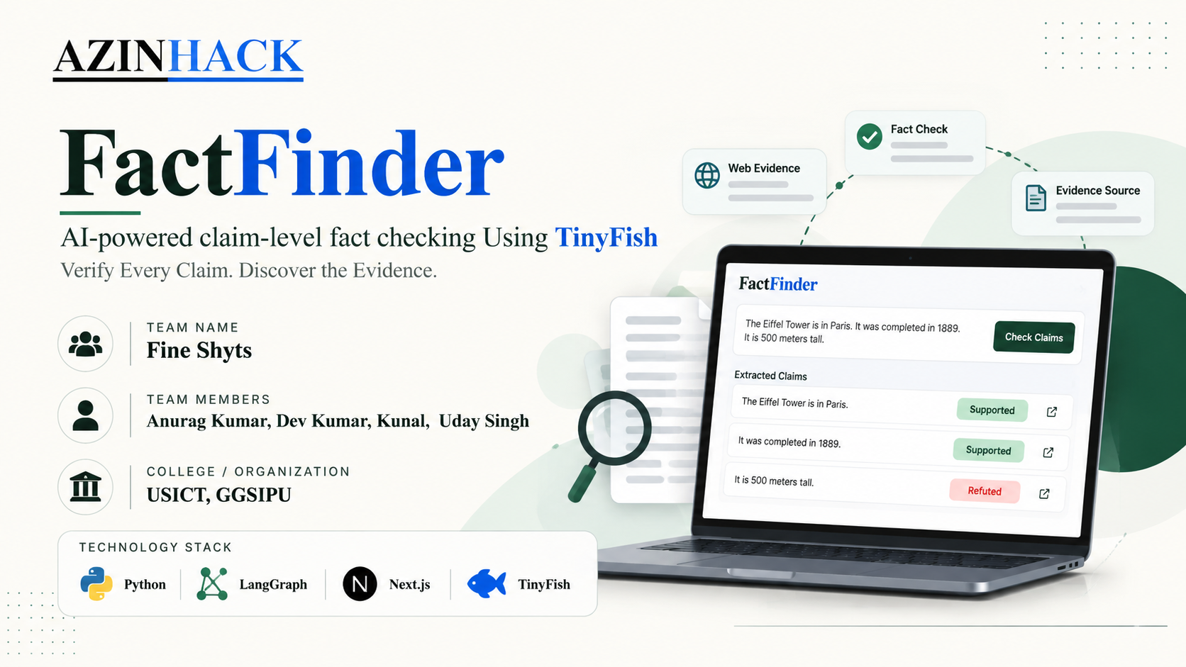
Notes:
Opening slide. ClaimAI checks AI-written text claim by claim instead of giving one true/false label. Introduce the team (FactFinder, USICT) and the one-line idea: one answer contains many claims, and each claim gets its own verdict (supported, refuted or unresolved) with evidence behind it.

Slide 2
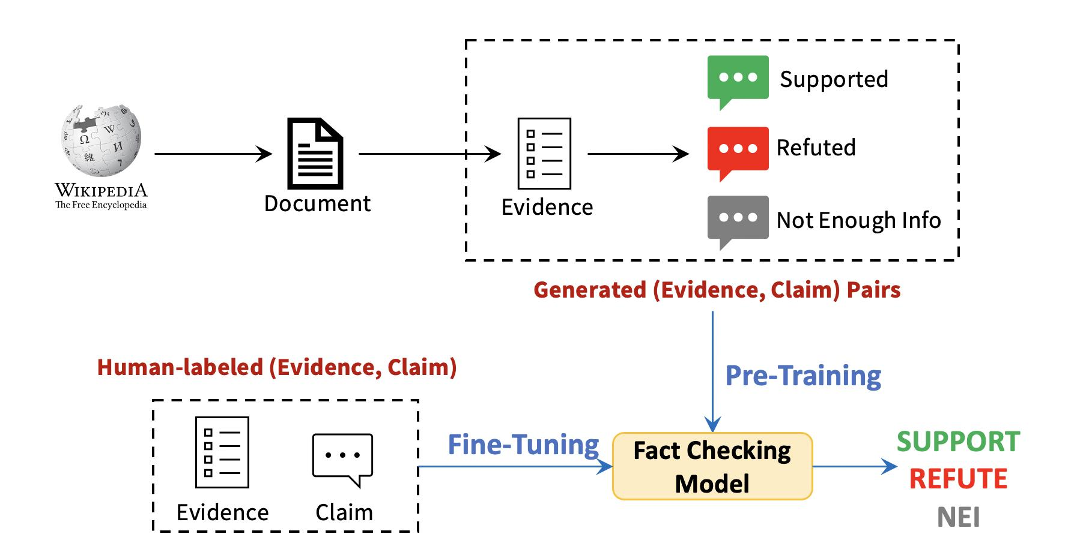
THE PROBLEM
One answer can contain many different truths.
Mixed information: An AI-generated answer may combine correct facts with outdated, misleading, or incorrect claims. Each factual claim needs to be checked independently.
Hidden errors: A single True/False label cannot show which statements are correct and which require correction.
Scattered evidence: Finding reliable web sources and comparing them against individual claims takes time.
Manual verification: Readers must research each statement themselves, making the process slow and difficult to scale.
THE SOLUTION : FactFinder breaks a statement into individual claims, searches for relevant web evidence using the project's verification workflow, and classifies each claim as Supported, Refuted, or Insufficient Evidence. It provides explanations and confidence levels to help users understand the results.
Notes:
The problem: LLM answers sound confident, but one paragraph usually mixes true statements with weak or wrong ones. In the example, the first two claims are correct and the 500 m height is wrong (the tower is roughly 330 m). A single "mostly true" label hides this, so the reader cannot tell what to correct and must re-check everything. The solution: split the answer into claims and verify each one separately.

Slide 3
THE SOLUTION
Check every claim, not just the answer.
TRADITIONAL CHECK
CLAIMAI
Whole answer
True / False?
Claim 1
Supported
Answer
Claim 2
Supported
One label for the whole answer. You cannot tell which sentence is wrong.
Claim 3
Refuted
THREE POSSIBLE RESULTS
Supported
Refuted
Unresolved
Reliable sources found online agree with the claim, so it can be kept as it is.
Sources directly contradict the claim, so this is the exact statement that needs to be corrected.
Evidence conflicts or stays thin even after retries. Shown honestly as open, not guessed.
Notes:
Traditional checking gives one label for the whole answer. ClaimAI reverses this: each statement is evaluated on its own and the verdict is attached to it. Three outcomes exist. Supported: reliable sources agree. Refuted: sources directly contradict the claim. Unresolved: evidence conflicts or is not enough even after retries; the system deliberately does not force a guess.

Slide 4
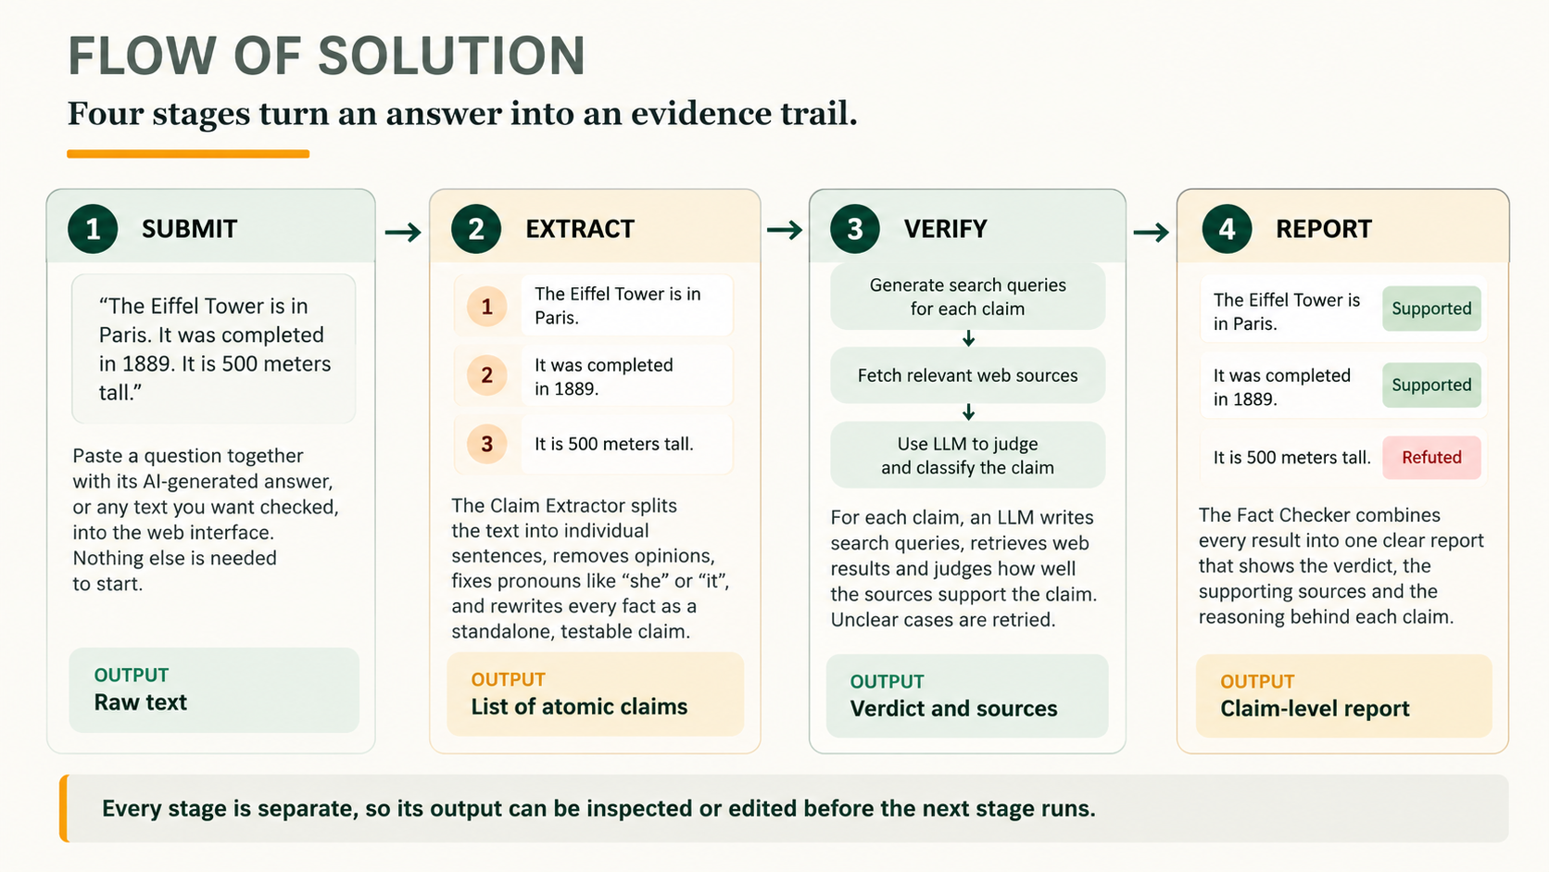
Notes:
End-to-end flow. 1) Submit: the user enters a question and answer, or any text. 2) Extract: the text becomes standalone, atomic claims. 3) Verify: every claim gets its own web search and evidence review. 4) Report: everything is assembled into a claim-by-claim report. Because each stage is a separate module, a reviewer can inspect the output of any stage, which is what makes the system explainable.

Slide 5
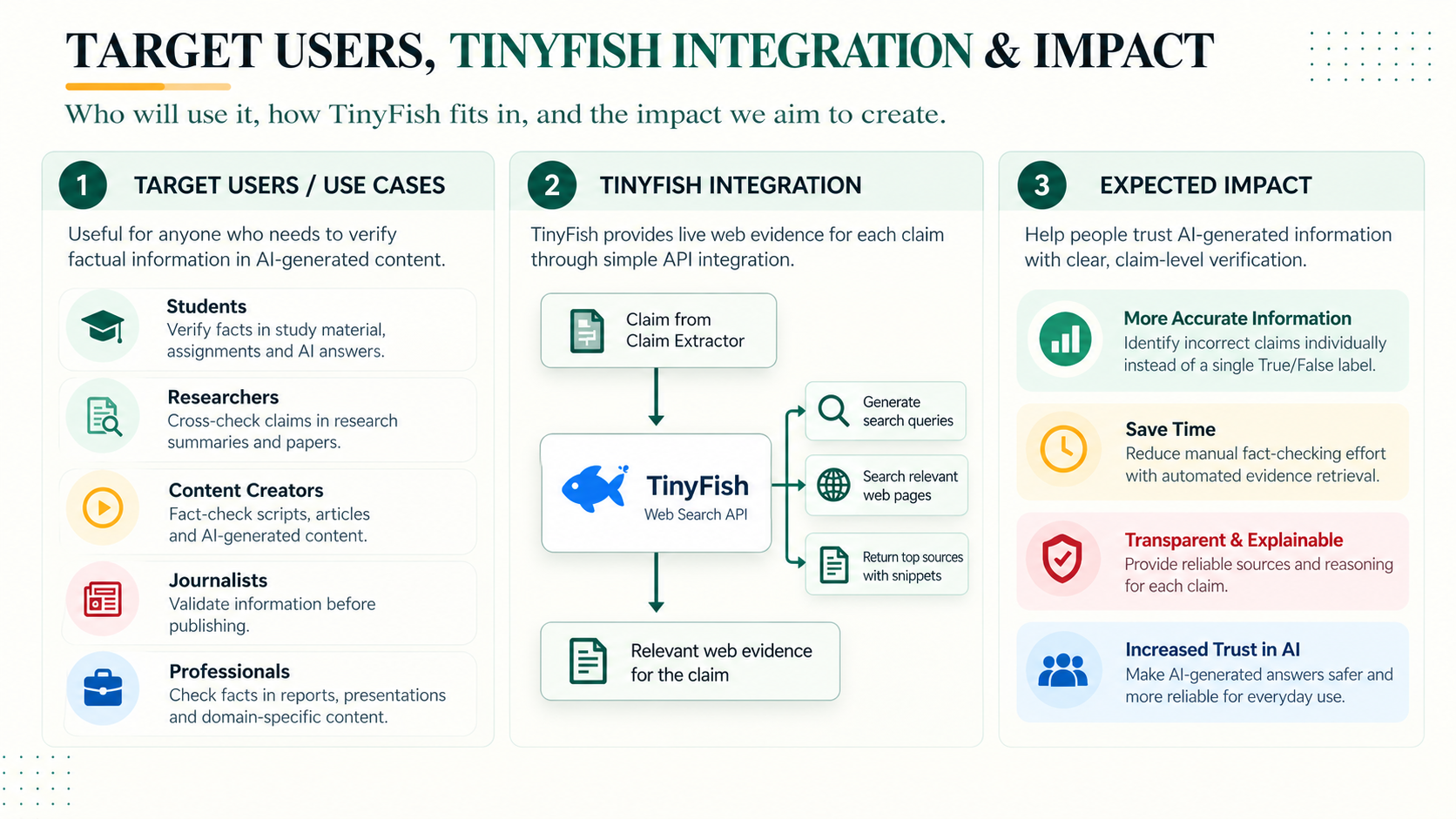

Slide 6
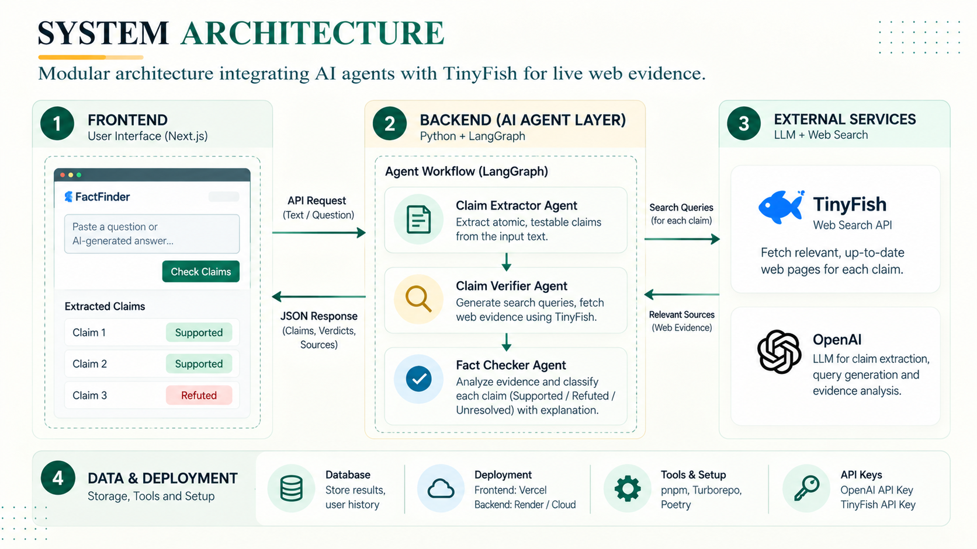

Slide 7
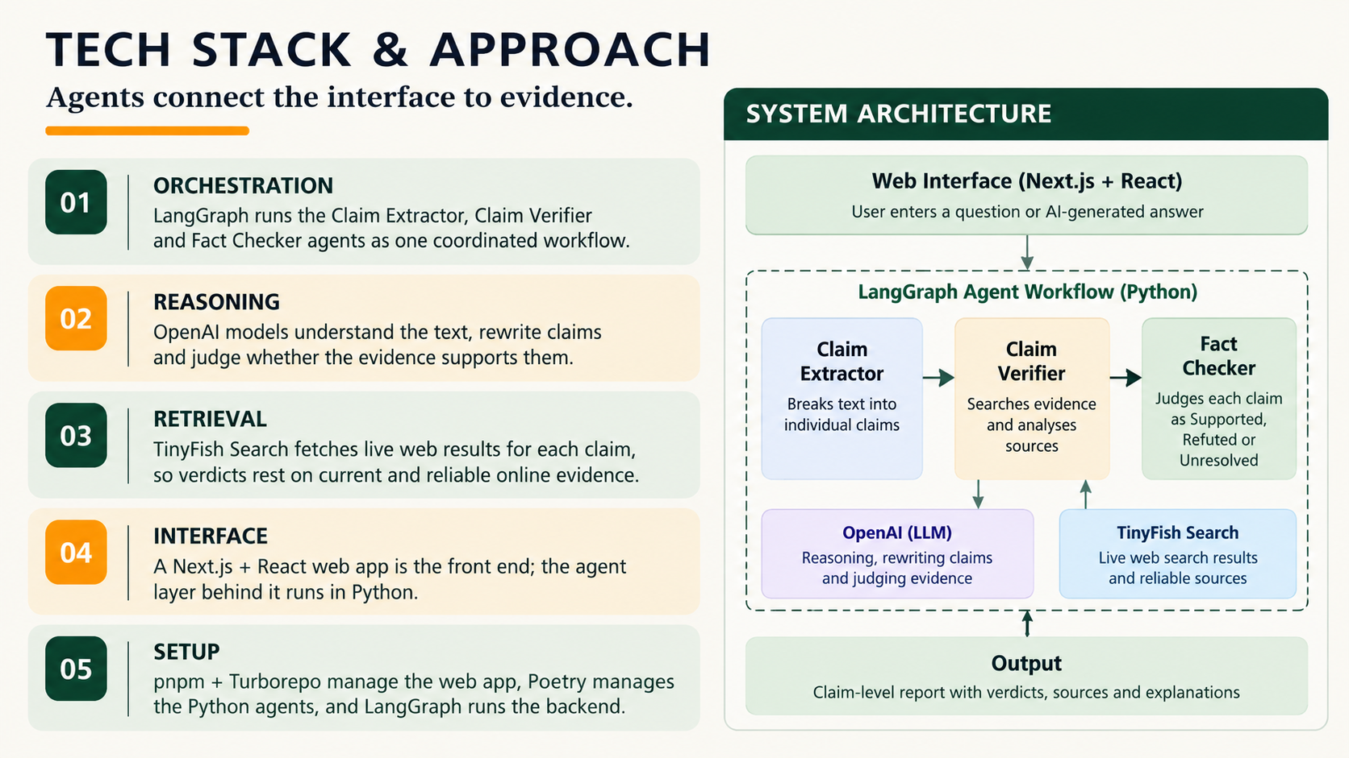
Notes:
The browser interface is built with Next.js and React. It talks to a Python agent layer orchestrated by LangGraph. The three agents run in sequence: Claim Extractor, Claim Verifier, Fact Checker. OpenAI models provide language understanding and reasoning inside the extractor and verifier, and Tavily Search supplies live web evidence to the verifier. Setup uses pnpm and Turborepo for the monorepo and Poetry for the Python packages. API keys needed: OpenAI and Tavily.

Slide 8
MODULE 1: CLAIM EXTRACTOR
Turning messy text into testable claims.
1
Split
2
Select
3
Disambiguate
4
Decompose
Break the text into sentences while keeping the surrounding context.
Keep only sentences that contain a verifiable fact. Opinions and vague statements are dropped.
Resolve pronouns and vague references. Several LLM votes settle unclear cases, or drop them.
Rewrite each sentence into standalone, atomic claims that can be checked independently.
EXAMPLE
“Marie Curie won two Nobel Prizes, and she discovered polonium.”
“she” becomes “Marie Curie”
Marie Curie won two Nobel Prizes.
Marie Curie discovered polonium.
Configurable in the config folder: LLM temperature, number of votes and more. The method is based on Claimify (Metropolitansky & Larson, 2025); the voting step is an addition by this project.
6
Notes:
The extractor follows the Claimify methodology. Split: the text is broken into sentences with context kept. Select: sentences without a verifiable fact, such as opinions, are removed. Disambiguate: pronouns and vague references are resolved, so "she" becomes "Marie Curie"; when a sentence is ambiguous, several LLM votes decide whether it can be fixed or should be dropped (the voting is an extra added by this project). Decompose: each sentence becomes one or more self-contained atomic claims.

Slide 9
MODULE 2: CLAIM VERIFIER
Each claim is checked against live evidence.
Claim
Search queries
Tavily search
Judge evidence
Verdict
One atomic statement
LLM writes focused search queries
Top web results are fetched
LLM compares the claim with sources
Final result for the claim
Unresolved? Retry with new search queries
Supported
Sources agree with the claim.
Refuted
Sources directly contradict it.
Unresolved
Conflicting or thin evidence, even after retries.
Retry loop: if the evidence is unclear, the LLM writes new queries and searches again before deciding. Configurable: number of web results, retry attempts and LLM temperature.
7
Notes:
The verifier takes one claim at a time. An LLM writes search queries, Tavily returns web results, and the LLM judges how the evidence relates to the claim. Using search results to check individual claims is inspired by SAFE (Wei et al., 2024). If the first attempt is ambiguous, a multi-retry loop searches again with new queries before giving up. If the evidence is still conflicting or too thin, the claim is reported as Unresolved. The number of search results and retry attempts are configurable.

Slide 10
MODULE 3: FACT CHECKER
One report, with the evidence path for every claim.
The Fact Checker is the orchestrator. It calls the extractor, sends every claim to the verifier, and then builds the final report, so you see the overall picture and every individual claim in one place.
SAMPLE REPORT (ILLUSTRATIVE)
Eiffel Tower is in Paris.
Supported
Completed in 1889.
Supported
It is 500 meters tall.
Refuted
Claim with conflicting sources.
Unresolved
Evidence path: for every claim the report keeps the search queries, the retrieved sources and the reasoning behind the verdict, so any result can be traced and double-checked.
8
Notes:
The Fact Checker is the orchestrator. It calls the extractor, sends every claim to the verifier, and assembles one report. The table and graph are illustrative sample data, not real benchmark results: four claims, of which two are supported, one is refuted and one is unresolved. The graph gives the overall picture at a glance, while the table shows exactly which statement needs attention.

Slide 11
FEASIBILITY & COMPETITORS
FactFinder makes uncertainty inspectable.
Capability | Generic chat | Basic search | FactFinder
Primary output | An answer | A list of sources | Claim-level results
Checks each statement | No | No | Yes
Evidence path | Not necessarily structured | Retrieved sources only | Linked to each claim
Uncertainty | May be hidden | Needs interpretation | Supported, refuted or unresolved
WHY IT MATTERS
Claim-level
Explainable
Honest
Controllable
Each statement is judged on its own, so uncertainty stays attached to the exact claim that needs review.
Extraction, retrieval, verification and reporting are separate stages, so each can be inspected.
Conflicting or insufficient evidence stays visible as unresolved instead of being forced into true or false.
LLM voting and multi-retry search give ambiguous cases a path to a better answer.
9
Notes:
A generic chatbot returns an answer but no structured evidence path, and uncertainty can hide in confident wording. A basic search engine returns sources, but the user must read and interpret them. ClaimAI sits between the two: claim-level verdicts with the evidence linked to each claim. The four boxes explain why it matters: claim-level results, explainable separate stages, honest unresolved outcomes, and practical controls (voting and multi-retry).

Slide 12
FEASIBILITY, SETUP & RESEARCH
Feasible now, with a clear path ahead.
RUN IT LOCALLY
Install tools
Add API keys
pnpm setup:dev
pnpm dev
Node 22+, pnpm 10, Python 3.11+, Poetry 2.1+ and the LangGraph CLI
Copy .env.example to .env and add OPENAI_API_KEY and TAVILY_API_KEY
Installs the web (pnpm) and Python (Poetry) packages in one command
Starts the web app and the agents; open localhost:3000
1
2
3
NOW · Feasible today
NEXT · Evaluation agent
LATER · Public API service
Local full-stack demo
Web interface + agent workflow
Open source (MIT)
Evaluation agent for overall performance
Accuracy and reliability metrics
Public API for other apps, no local setup needed
Robust hosted service
Research basis: Claimify (Metropolitansky & Larson, 2025) for claim extraction and SAFE (Wei et al., 2024) for evidence retrieval.
10
Notes:
Run it locally: install the tools, add the OpenAI and Tavily keys to .env, run pnpm setup:dev, then pnpm dev and open localhost:3000. Roadmap: Now, a working local full-stack demo. Next, an evaluation agent that measures how accurate and reliable the fact checking itself is. Later, a public API so other applications can use ClaimAI without running it locally. Close by crediting the research (Claimify and SAFE).

